Slide 1




SENTNEL-AI
Team Name:SYNTHETIX
Team Members:
Deepak R
Bharath B
Shrishanth B L
Nakul H C
Team ID:AH-45

Slide 2

2/7
Theme & Problem Statement
Theme: AGENTIC AI AND MULTI AGENT SYSTEMS
SENTINEL AI is the lack of a unified intelligent platform to detect cyber threats, identify unauthorized access, investigate suspicious activities, assess risks, and recommend appropriate security responses across different organizations.

Slide 3
3/7
Proposed Solution
Intelligent Threat Detection: Uses specialized AI agents to identify suspicious activities, unauthorized access, and potential cyber threats from security logs.
Automated Investigation & Risk Assessment: Analyzes security incidents, creates timelines, calculates risk scores, and verifies digital document integrity using SHA-256.
Smart Response & Monitoring: Recommends suitable security actions for human approval, verifies simulated responses, and maintains investigation reports and audit records.

Slide 4
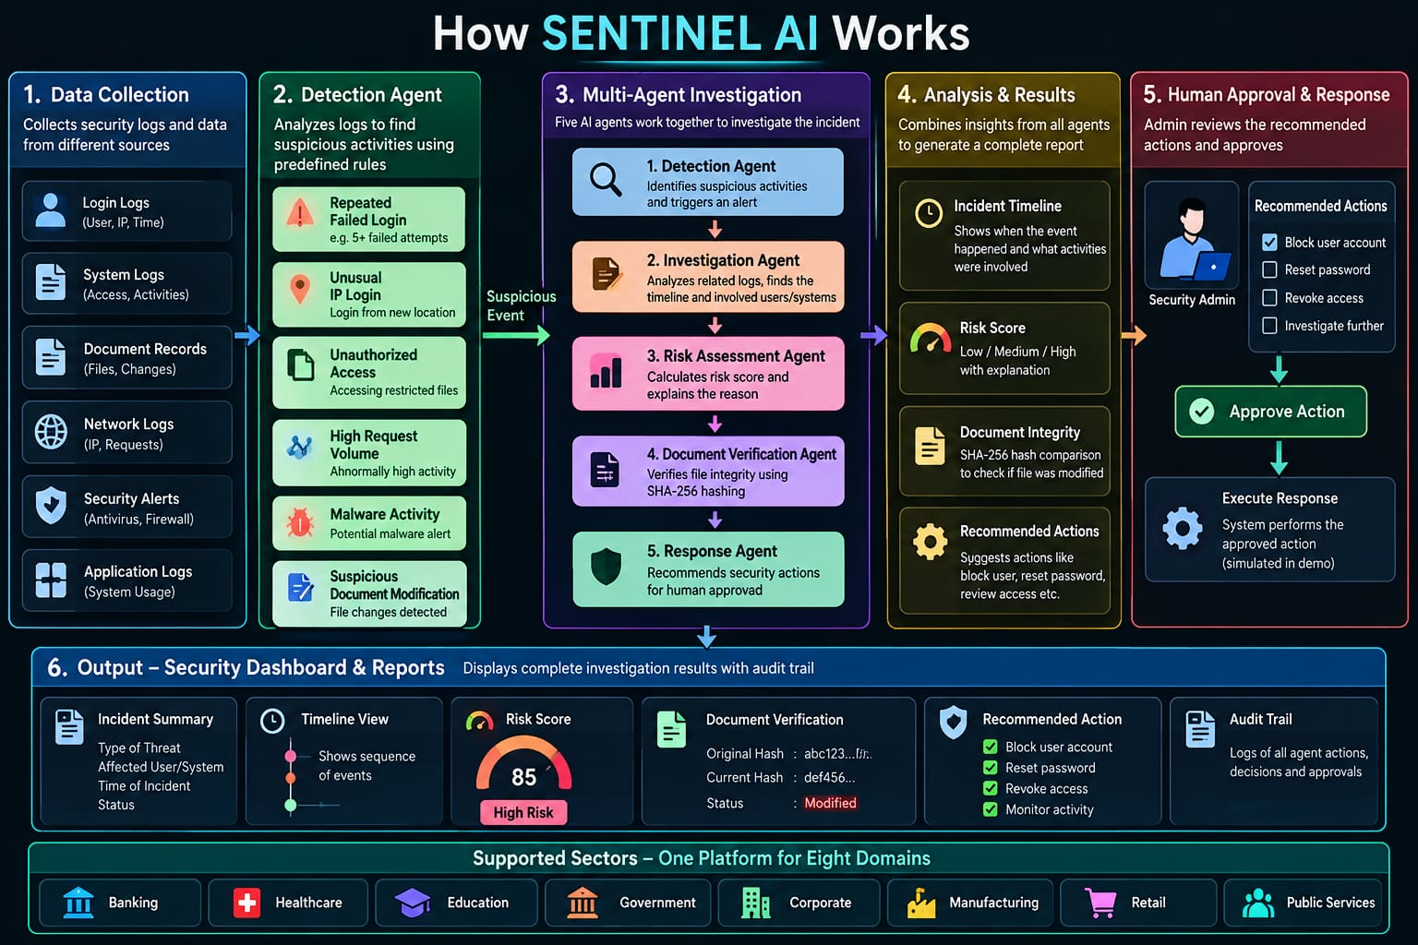
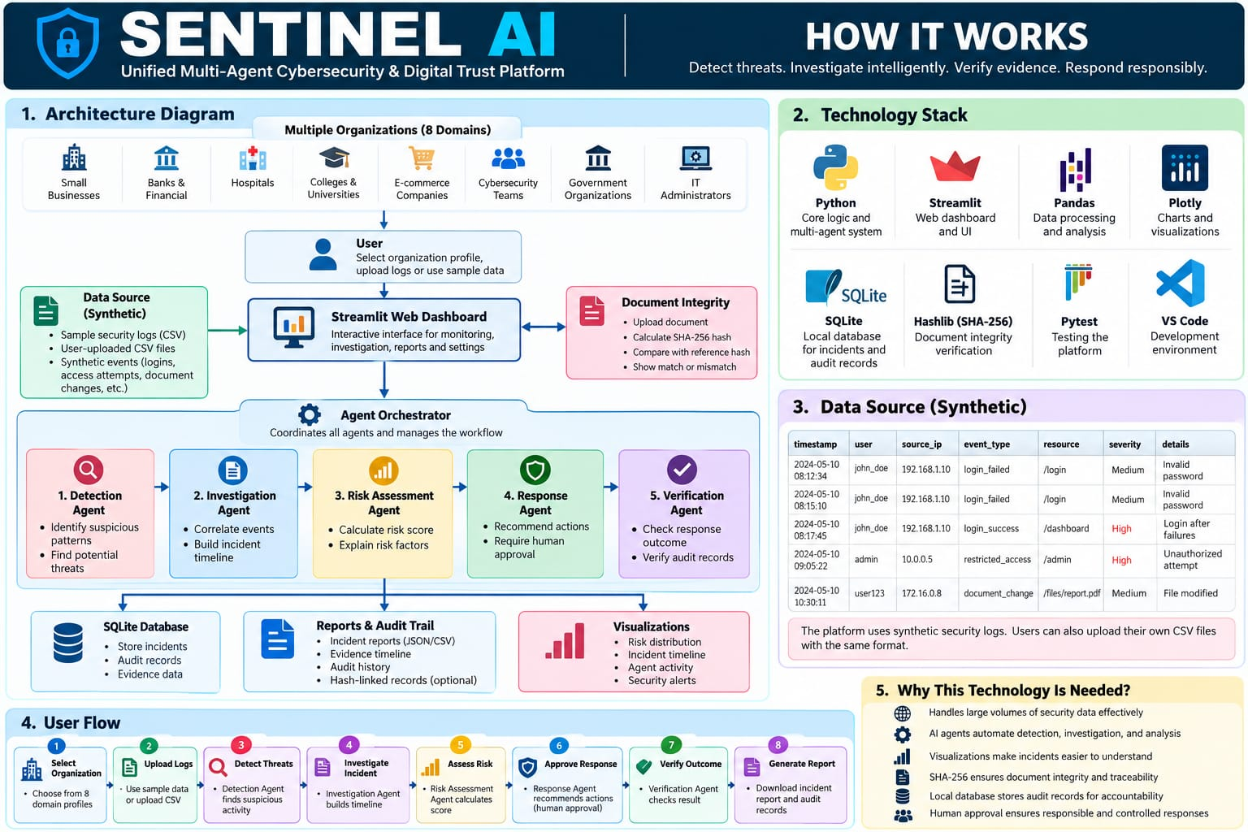
7/7
How it works

Slide 5
7/7
What we will Build
Unified Security Dashboard: A single web application with eight configurable organizational profiles.
Threat Detection: Identify suspicious activities from uploaded or synthetic security logs.
Multi-Agent Investigation: Five specialized agents detect threats, investigate incidents, assess risks, recommend responses, and verify outcomes.
Risk Assessment: Calculate and display explainable risk scores with incident timelines.
Document Integrity: Use SHA-256 hashing to verify whether documents match their reference versions.
Human-Approved Response: Recommend security actions, simulate approved responses, and verify their outcomes.
Reports & Audit Trail: Store incident records and generate downloadable investigation reports.

